Slide 1
Application of Database in Retail Business
AGENO SCHOOL OF BUSINESS
Golden Gate University
MSBA 304-Database Theory and Data Management Tools
Helen Yelluas, MSEE
Spring 2020
Team Members:
Fengmin Ye (Jason)-0596697
Anurag Sengupta-0597276
Reena Sehitya-0597218
Notes:
Golden Gate University
www.ggu.edu

Slide 2
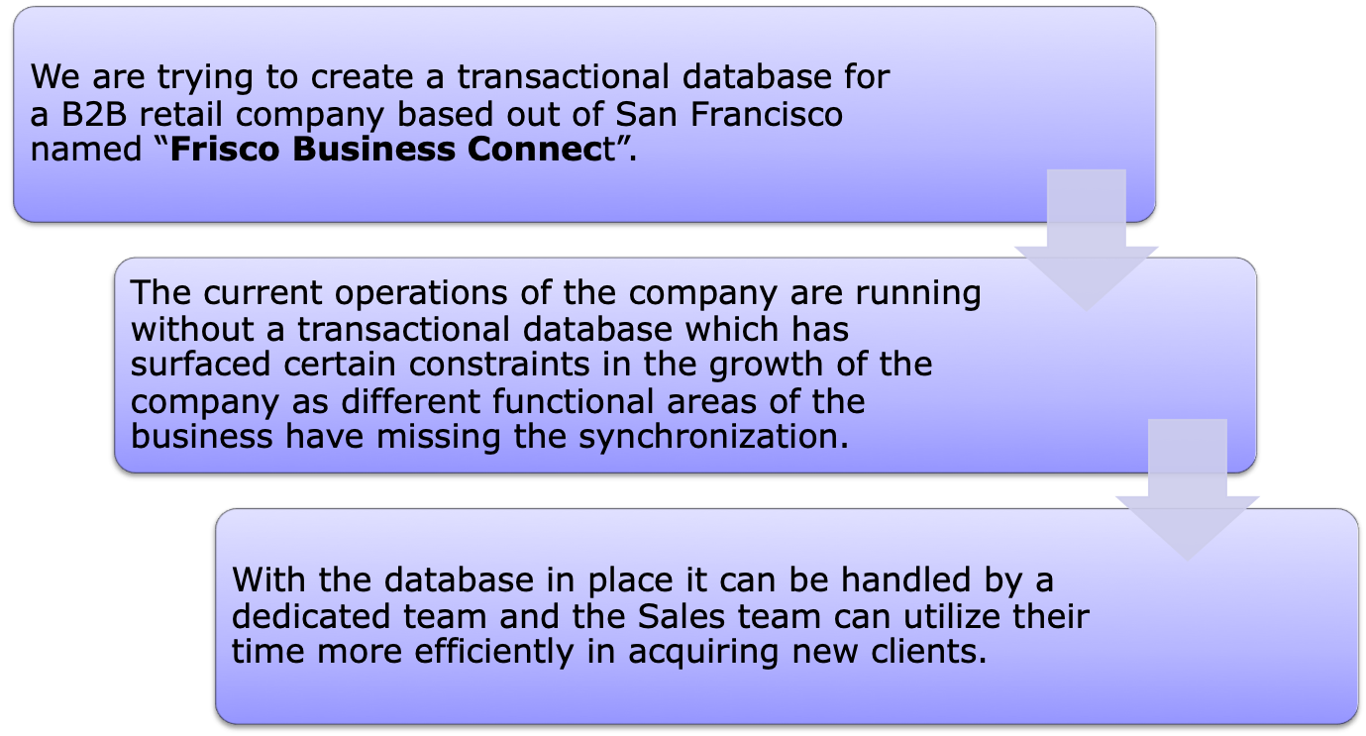
Business Story

Slide 3
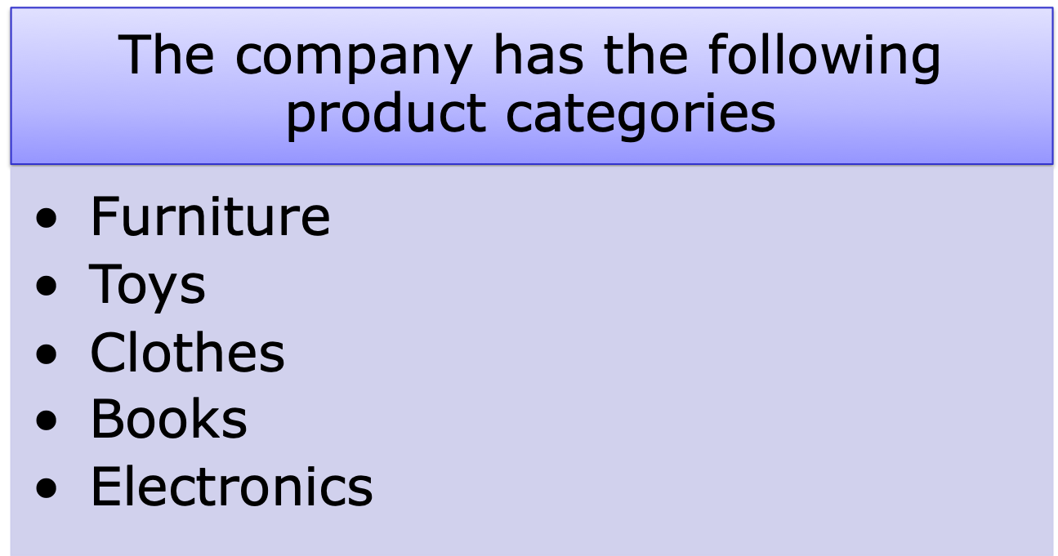
Business Story

Slide 4
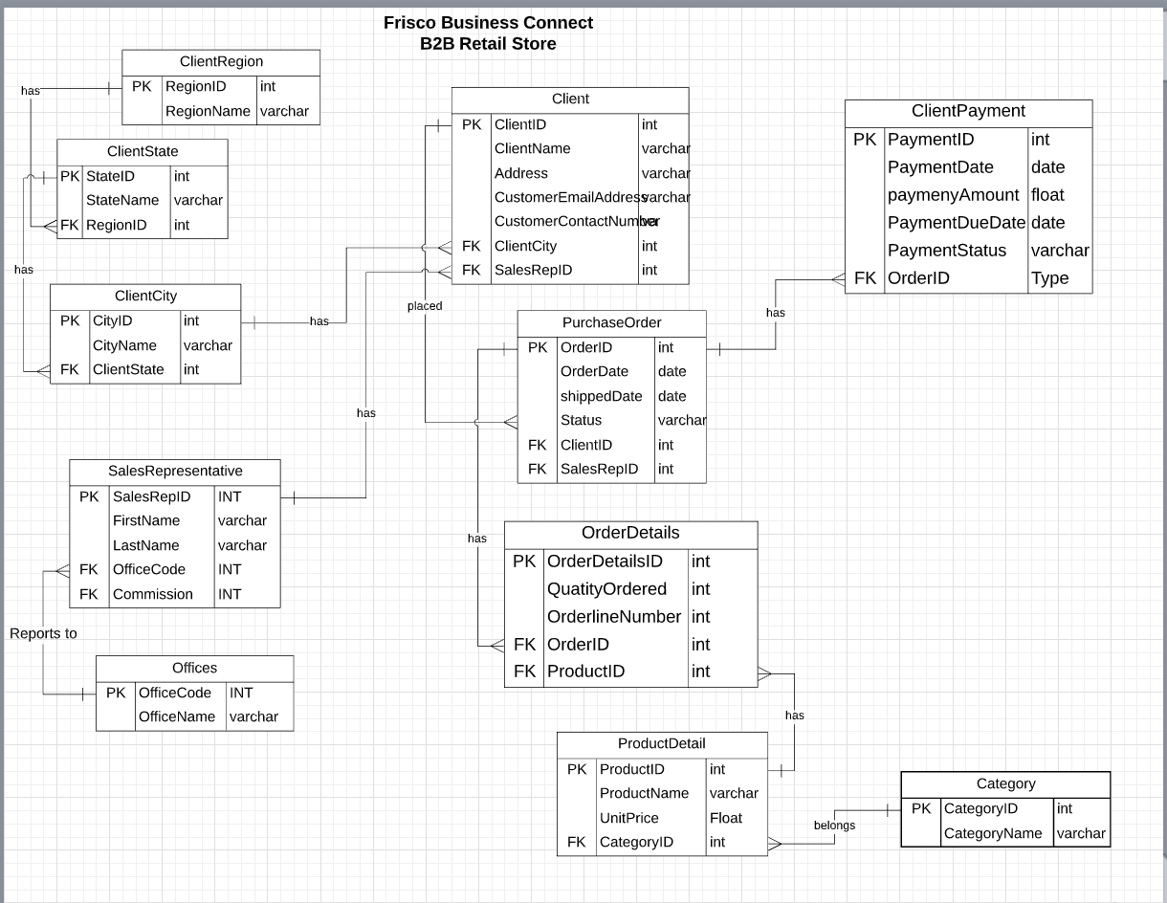
ERD

Slide 5
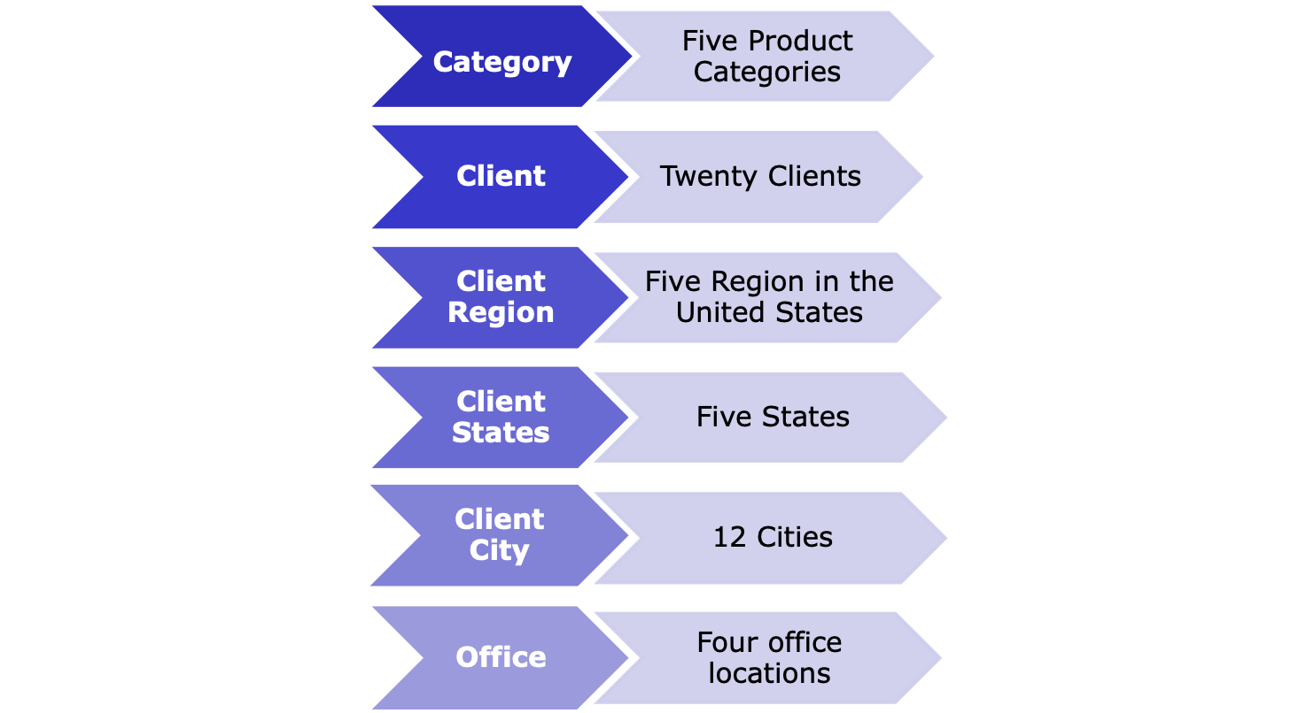
Entities & Number of Records

Slide 6
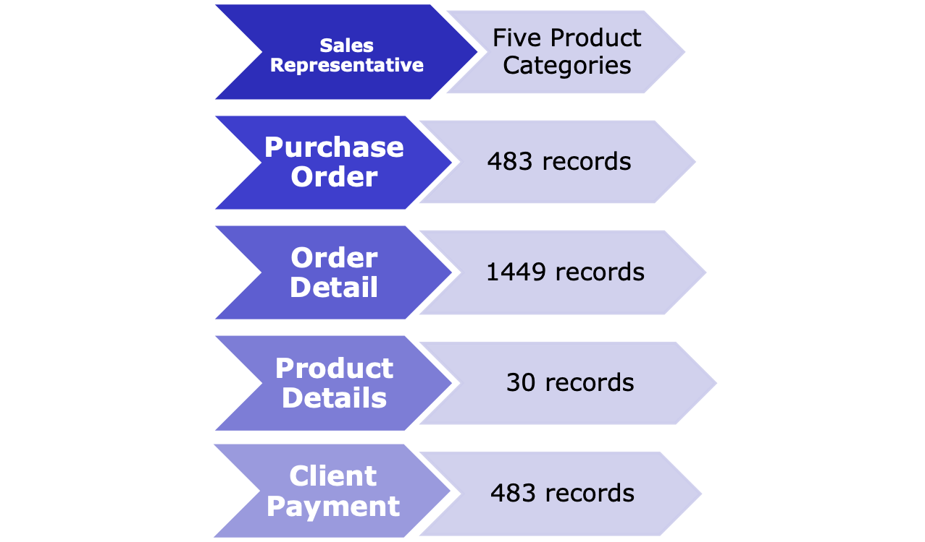
Entities & Number of Records contd.

Slide 7
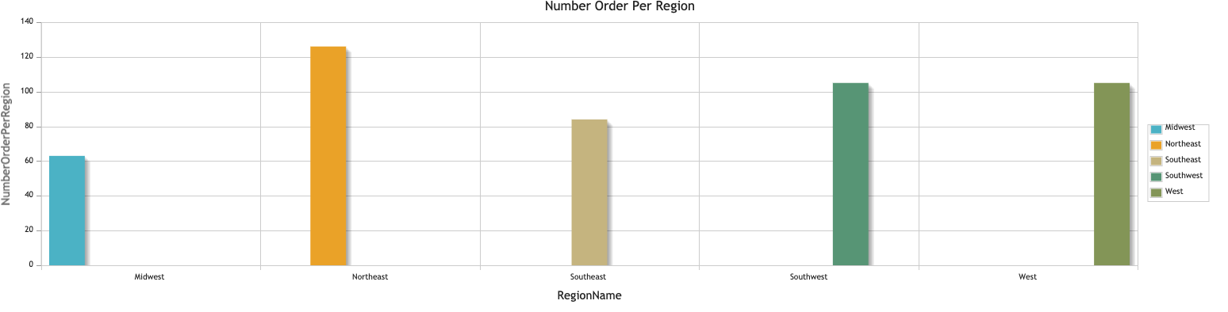
Number of Orders per Region for the last 6 years
SELECT Count(FP_PurchaceOrder.OrderID) AS NumberOrderPerRegion, FP_ClientRegion.RegionName
FROM FP_PurchaceOrder, FP_Client, FP_ClientCity, FP_ClientState, FP_ClientRegion
WHERE FP_PurchaceOrder.ClientID = FP_Client.ClientID
AND FP_Client.CityID = FP_ClientCity.CityID
AND FP_ClientCity.StateID = FP_ClientState.StateID
AND FP_ClientState.RegionID = FP_ClientRegion.RegionID
GROUP BY 2

Slide 8
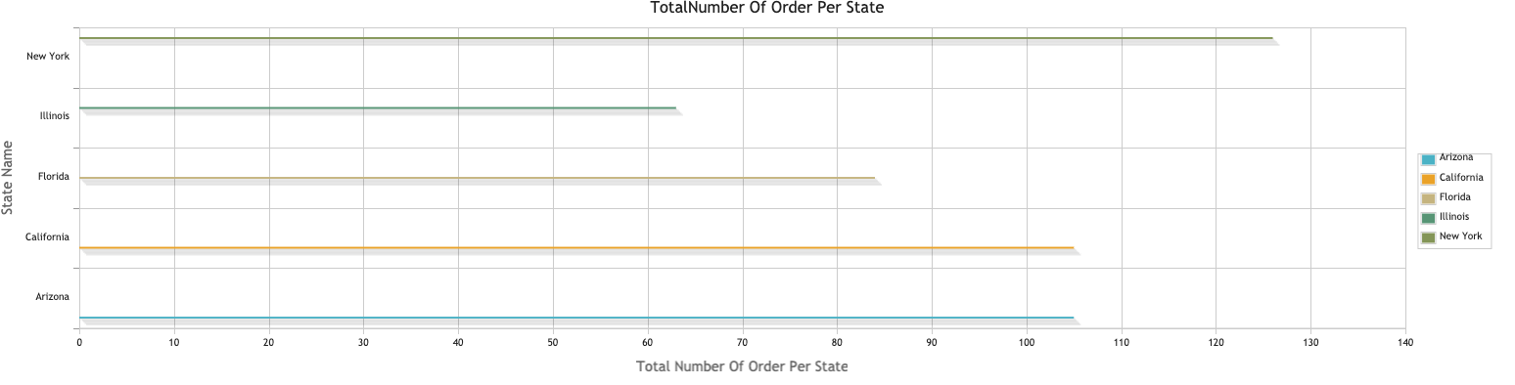
Number of Orders per State for the last 6 years
SELECT Count(FP_PurchaceOrder.OrderID) AS TotalNumberOfOrderPerState, FP_ClientState.StateName
FROM FP_PurchaceOrder, FP_Client, FP_ClientCity, FP_ClientState
WHERE FP_PurchaceOrder.ClientID = FP_Client.ClientID
AND FP_Client.CityID = FP_ClientCity.CityID
AND FP_ClientCity.StateID = FP_ClientState.StateID
GROUP BY 2

Slide 9
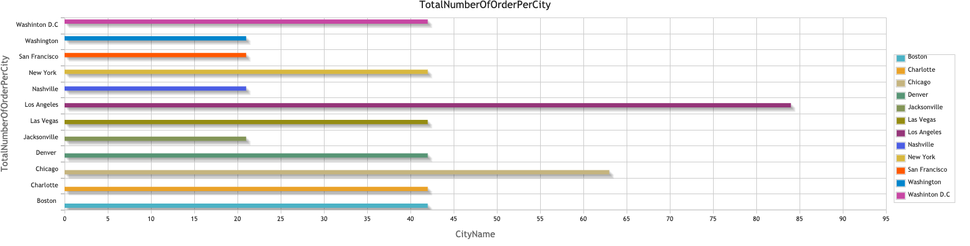
Number of Orders per City for the last 6 years
SELECT Count(FP_PurchaceOrder.OrderID) AS TotalNumberOfOrderPerCity, FP_ClientCity.CityName
FROM FP_PurchaceOrder, FP_Client, FP_ClientCity
WHERE FP_PurchaceOrder.ClientID = FP_Client.ClientID
AND FP_Client.CityID = FP_ClientCity.CityID
GROUP BY 2

Slide 10
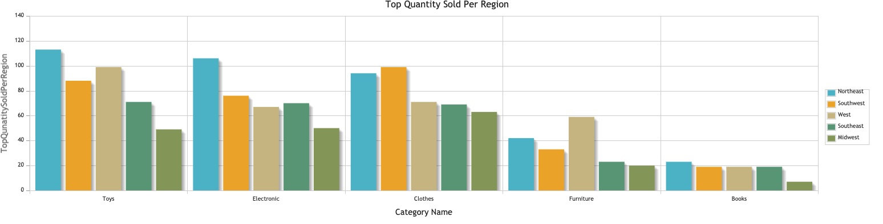
Category: Top 5 quantity sold as per Region for the last 6 years
SELECT FP_Cetgory.CategoryName, Count(FP_ProductDetail.CategoryID) TopQunatitySoldPerRegion ,FP_ClientRegion.RegionName
FROM FP_Cetgory,FP_ProductDetail, FP_OrderDetail, FP_PurchaceOrder, FP_Client, FP_ClientCity, FP_ClientState, FP_ClientRegion
WHERE FP_PurchaceOrder.ClientID = FP_Client.ClientID AND FP_Cetgory.CategoryID = FP_ProductDetail.CategoryID
AND FP_ProductDetail.ProductID = FP_OrderDetail.ProductID AND FP_PurchaceOrder.OrderID = FP_OrderDetail.OrderID
AND FP_Client.CityID = FP_ClientCity.CityID AND FP_ClientCity.StateID = FP_ClientState.StateID
AND FP_ClientState.RegionID = FP_ClientRegion.RegionID GROUP BY 1,3
ORDER by 2 DESC
Limit 5

Slide 11
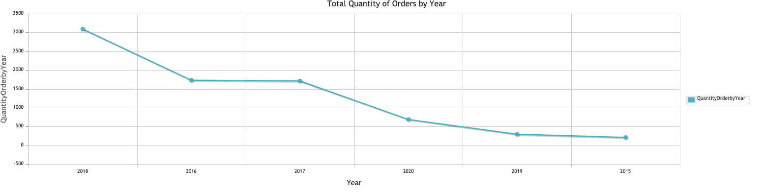
Total Quantity of Orders by Year (6 years)
SELECT SUM(FP_OrderDetail.QuantityOrdered) as QuantityOrderbyYear, Year(FP_PurchaceOrder.OrderDate)
FROM FP_OrderDetail, FP_PurchaceOrder
WHERE FP_OrderDetail.OrderID = FP_PurchaceOrder.OrderID
GROUP BY 2
Order by 1 DESC

Slide 12
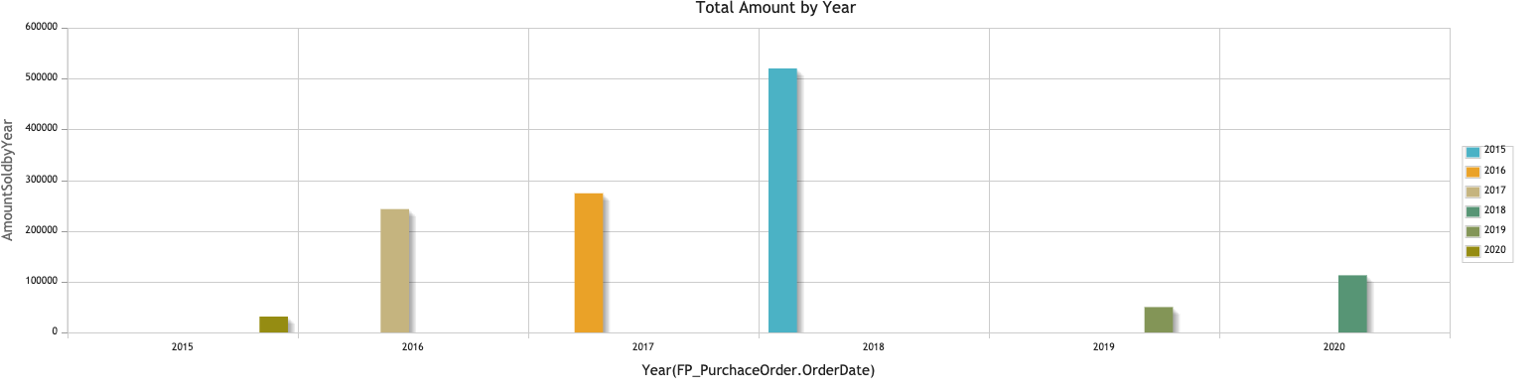
Total Amount by Year (6 years)
SELECT SUM(FP_OrderDetail.QuantityOrdered * FP_ProductDetail.UnitPrice ) as AmountSoldbyYear, Year(FP_PurchaceOrder.OrderDate)
FROM FP_OrderDetail, FP_PurchaceOrder, FP_ProductDetail
WHERE FP_OrderDetail.OrderID = FP_PurchaceOrder.OrderID
AND FP_ProductDetail.ProductID = FP_OrderDetail.ProductID
GROUP BY 2
Order by 1 DESC

Slide 13
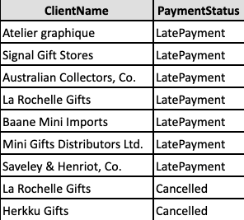
Name of the Clients who have either made late payment or cancelled the order for last 6 years
SELECT DISTINCT(FP_Client.ClientName), FP_ClientPayment.PaymentStatus
FROM
FP_Client, FP_PurchaceOrder, FP_ClientPayment
WHERE
FP_Client.ClientID = FP_PurchaceOrder.ClientID
AND FP_PurchaceOrder.OrderID = FP_ClientPayment.OrderID
AND FP_ClientPayment.PaymentStatus IN ('LatePayment', 'Cancelled')

Slide 14
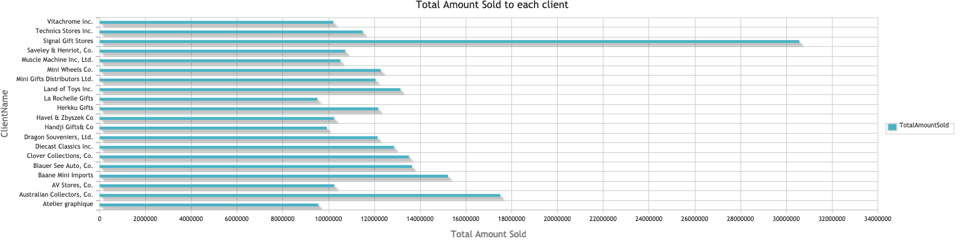
Total Amount Sold to each client for last 6 years
SELECT DISTINCT(FP_Client.ClientName), SUM(FP_ProductDetail.UnitPrice * FP_OrderDetail.OrderID) AS TotalAmountSold
FROM FP_Client, FP_PurchaceOrder, FP_OrderDetail, FP_ProductDetail
WHERE FP_Client.ClientID = FP_PurchaceOrder.ClientID
AND FP_PurchaceOrder.OrderID = FP_OrderDetail.OrderID
AND FP_OrderDetail.ProductID = FP_ProductDetail.ProductID
group by 1

Slide 15
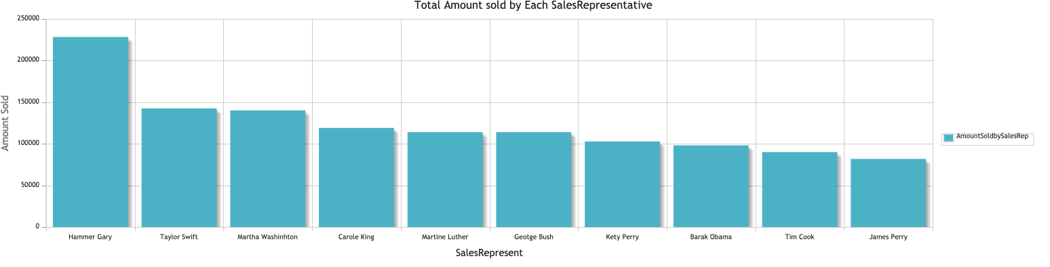
Total Amount sold by Each Sales Representative for the last 6 years
SELECT DISTINCT(CONCAT(FP_SalesRepresentative.FirstName,' ', FP_SalesRepresentative.LastName)) AS SalesRepresent, SUM(FP_OrderDetail.QuantityOrdered * FP_ProductDetail.UnitPrice ) AS AmountSoldbySalesRep
FROM FP_OrderDetail, FP_PurchaceOrder, FP_ProductDetail, FP_Client, FP_SalesRepresentative
WHERE FP_OrderDetail.OrderID = FP_PurchaceOrder.OrderID AND FP_ProductDetail.ProductID = FP_OrderDetail.ProductID AND FP_Client.SalesRepID = FP_SalesRepresentative.SalesRepID AND FP_Client.ClientID = FP_PurchaceOrder.ClientID
GROUP BY 1
Order by 2 DESC

Slide 16
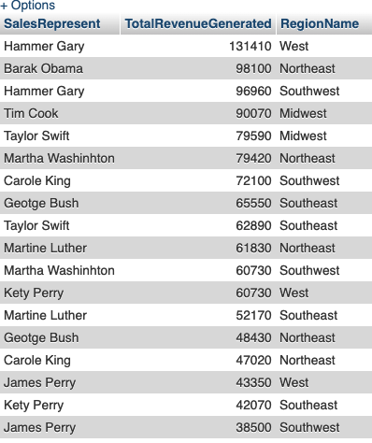
Total Revenue generated by each Sales Representative in Each Region for the last 6 years
SELECT DISTINCT(CONCAT(FP_SalesRepresentative.FirstName,' ', FP_SalesRepresentative.LastName)) AS SalesRepresent, SUM(FP_OrderDetail.QuantityOrdered * FP_ProductDetail.UnitPrice ) AS TotalRevenueGenerated, FP_ClientRegion.RegionName
FROM FP_OrderDetail, FP_PurchaceOrder, FP_ProductDetail, FP_Client, FP_SalesRepresentative, FP_ClientCity, FP_ClientState, FP_ClientRegion
WHERE FP_OrderDetail.OrderID = FP_PurchaceOrder.OrderID
AND FP_ProductDetail.ProductID = FP_OrderDetail.ProductID
AND FP_Client.SalesRepID = FP_SalesRepresentative.SalesRepID
AND FP_Client.ClientID = FP_PurchaceOrder.ClientID
AND FP_Client.CityID = FP_ClientCity.CityID
AND FP_ClientCity.StateID = FP_ClientState.StateID
AND FP_ClientState.RegionID = FP_ClientRegion.RegionID
GROUP BY 1,3
Order by 2 DESC

Slide 17
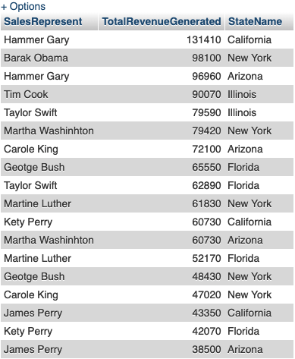
Total Revenue generated by each Sales Representative by States for the last 6 years
SELECT CONCAT(FP_SalesRepresentative.FirstName,' ', FP_SalesRepresentative.LastName) AS SalesRepresent, SUM(FP_OrderDetail.QuantityOrdered * FP_ProductDetail.UnitPrice ) AS TotalRevenueGenerated, FP_ClientState.StateName
FROM FP_OrderDetail, FP_PurchaceOrder, FP_ProductDetail, FP_Client, FP_SalesRepresentative, FP_ClientCity, FP_ClientState
WHERE FP_OrderDetail.OrderID = FP_PurchaceOrder.OrderID
AND FP_ProductDetail.ProductID = FP_OrderDetail.ProductID
AND FP_Client.SalesRepID = FP_SalesRepresentative.SalesRepID
AND FP_Client.ClientID = FP_PurchaceOrder.ClientID
AND FP_Client.CityID = FP_ClientCity.CityID
AND FP_ClientCity.StateID = FP_ClientState.StateID
GROUP BY 1,3
Order by 2 DESC

Slide 18
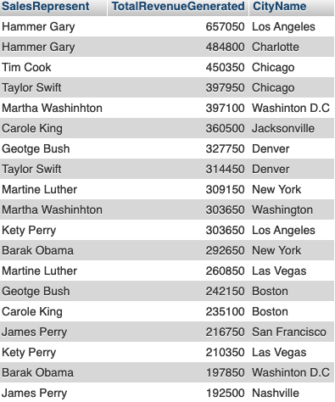
Total Revenue generated by each Sales Representative by City for the last 6 years
SELECT CONCAT(FP_SalesRepresentative.FirstName,' ', FP_SalesRepresentative.LastName) AS SalesRepresent, SUM(FP_OrderDetail.QuantityOrdered * FP_ProductDetail.UnitPrice ) AS TotalRevenueGenerated, FP_ClientCity.CityName
FROM FP_OrderDetail, FP_PurchaceOrder, FP_ProductDetail, FP_Client, FP_SalesRepresentative, FP_ClientCity, FP_ClientState
WHERE FP_OrderDetail.OrderID = FP_PurchaceOrder.OrderID
AND FP_ProductDetail.ProductID = FP_OrderDetail.ProductID
AND FP_Client.SalesRepID = FP_SalesRepresentative.SalesRepID
AND FP_Client.ClientID = FP_PurchaceOrder.ClientID
AND FP_Client.CityID = FP_ClientCity.CityID
GROUP BY 1,3
Order by 2 DESC

Slide 19
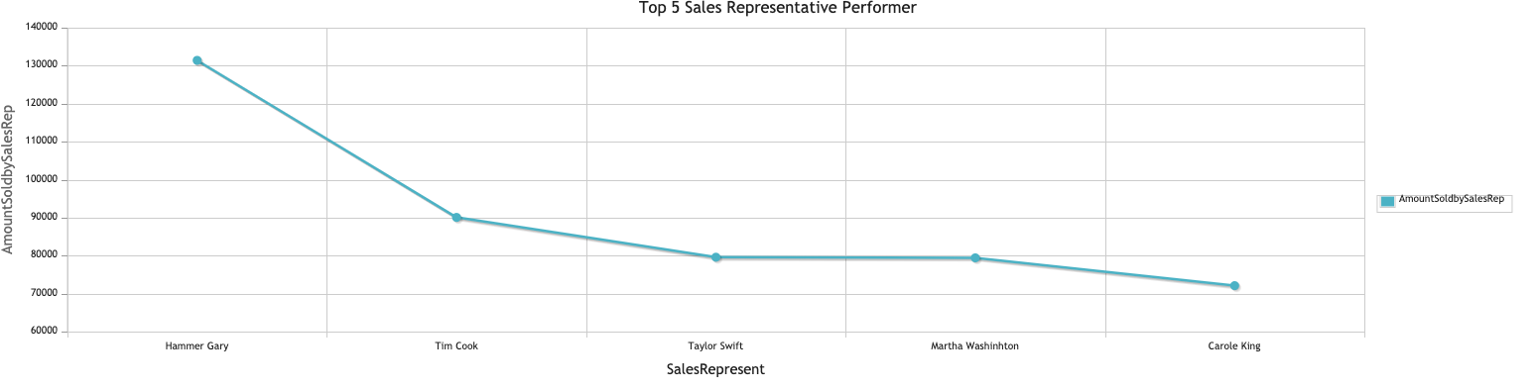
Top 5 Sales Representative Performer for the last 6 years
SELECT CONCAT(FP_SalesRepresentative.FirstName,' ', FP_SalesRepresentative.LastName) AS SalesRepresent, SUM(FP_OrderDetail.QuantityOrdered * FP_ProductDetail.UnitPrice ) AS AmountSoldbySalesRep, FP_Client.ClientID
FROM FP_OrderDetail, FP_PurchaceOrder, FP_ProductDetail, FP_Client, FP_SalesRepresentative
WHERE FP_OrderDetail.OrderID = FP_PurchaceOrder.OrderID
AND FP_ProductDetail.ProductID = FP_OrderDetail.ProductID AND FP_Client.SalesRepID = FP_SalesRepresentative.SalesRepID AND FP_Client.ClientID = FP_PurchaceOrder.ClientID
GROUP BY 1,3 Order by 2 DESC
limit 5

Slide 20
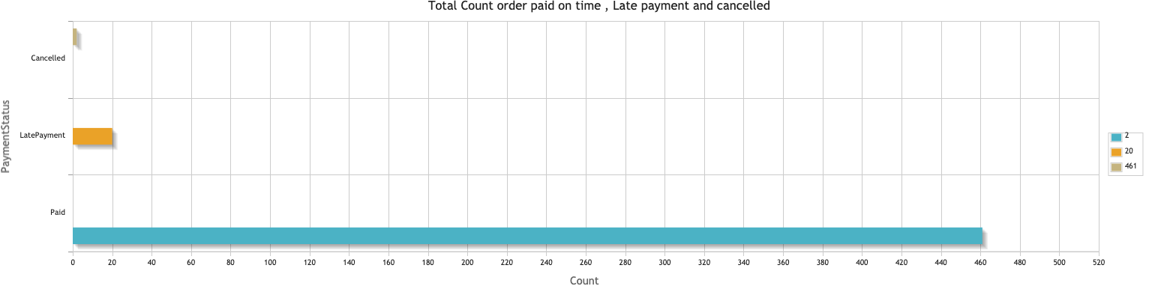
Total Count order paid on time , Late payment and cancelled for the last 6 years
SELECT PaymentStatus, count(PaymentStatus) AS CountofOrder FROM FP_ClientPayment
WHERE PaymentStatus in ('LatePayment', 'Cancelled', 'Paid')
GROUP by 1
Order by 1 DESC

Slide 21
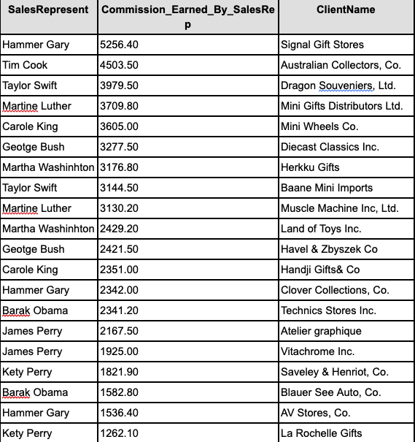
Total commission paid to Sales Representatives by Client for last the 6 years
SELECT CONCAT(FP_SalesRepresentative.FirstName,' ‘, FP_SalesRepresentative.LastName) AS SalesRepresent, ROUND(SUM(FP_OrderDetail.QuantityOrdered * FP_ProductDetail.UnitPrice * FP_SalesRepresentative.Commission),2) AS Commission_Earned_By_SalesRep, FP_Client.ClientName FROM FP_OrderDetail, FP_PurchaceOrder, FP_ProductDetail, FP_Client, FP_SalesRepresentative WHERE FP_OrderDetail.OrderID = FP_PurchaceOrder.OrderID
AND FP_ProductDetail.ProductID = FP_OrderDetail.ProductID
AND FP_Client.SalesRepID = FP_SalesRepresentative.SalesRepID
AND FP_Client.ClientID = FP_PurchaceOrder.ClientID
GROUP BY 1, 3
Order by 2 DESC

Slide 22
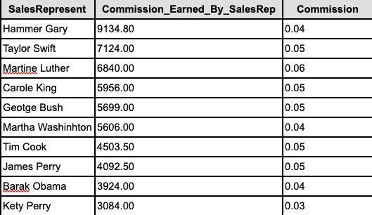
Total commission paid to Sales Representatives across all their Clients for the last 6 years
SELECT CONCAT(FP_SalesRepresentative.FirstName,' ', FP_SalesRepresentative.LastName) AS SalesRepresent,
ROUND(SUM(FP_OrderDetail.QuantityOrdered * FP_ProductDetail.UnitPrice * FP_SalesRepresentative.Commission),2) AS Commission_Earned_By_SalesRep,
FP_SalesRepresentative.Commission
FROM FP_OrderDetail, FP_PurchaceOrder, FP_ProductDetail, FP_Client, FP_SalesRepresentative
WHERE FP_OrderDetail.OrderID = FP_PurchaceOrder.OrderID
AND FP_ProductDetail.ProductID = FP_OrderDetail.ProductID
AND FP_Client.SalesRepID = FP_SalesRepresentative.SalesRepID
AND FP_Client.ClientID = FP_PurchaceOrder.ClientID
GROUP BY 1,3
Order by 2 DESC

Slide 23
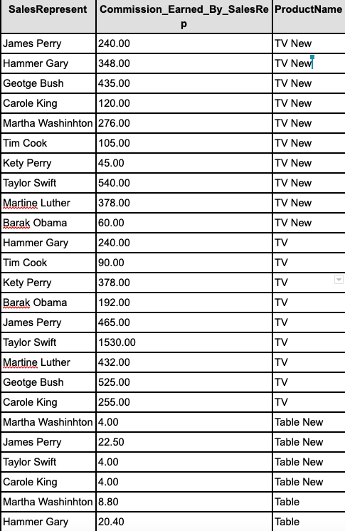
Total commission paid to Sales Representatives by Product for the last 6 years
SELECT CONCAT(FP_SalesRepresentative.FirstName,' ', FP_SalesRepresentative.LastName) AS SalesRepresent, ROUND(SUM(FP_OrderDetail.QuantityOrdered * FP_ProductDetail.UnitPrice * FP_SalesRepresentative.Commission),2) AS Commission_Earned_By_SalesRep, FP_ProductDetail.ProductName
FROM FP_OrderDetail, FP_PurchaceOrder, FP_ProductDetail, FP_Client, FP_SalesRepresentative
WHERE FP_OrderDetail.OrderID = FP_PurchaceOrder.OrderID
AND FP_ProductDetail.ProductID = FP_OrderDetail.ProductID
AND FP_Client.SalesRepID = FP_SalesRepresentative.SalesRepID
AND FP_Client.ClientID = FP_PurchaceOrder.ClientID
GROUP BY 1, 3
Order BY 3 DESC

